Slide 1


Slide 2
Syllogism

Slide 3
Venn diagrams are quite important when it comes to solving syllogism questions. With the help of these diagrams the question gets more clear and simplified.
One must not create any data of his own. It is important to follow only that data which is mention there in the question. In other words it can be said that a candidate must not assume anything and should only follow which is given there.
Words like few, at least, some etc are the basics to solve such type of questions. Pay attention to these words.
The only data to be followed while solving a syllogism question is the data mentioned in the question itself.

Slide 4
Quantifiers
Universal quantifiers
All (positive)
No (negative)
Particular quantifiers
Some (positive)
Some Not (negative)

Slide 5
Statements:
Some trees are papers
All papers are inks
Some ink are blue
Conclusions:
1.Some inks are trees
2. Some papers are trees
3. Some blue are paper
4. Some blue are ink
Only conclusion 2 follows B. Neither conclusion 1 nor 2 follows
Only conclusion 1 follows C. Both conclusion 1, 2 and 4 follows
Notes:
Ans D

Slide 6
Statements:
1.Some Cars are Trucks
2.Some Trucks are Cycles
3.All Cycles are Tractors
4. All Tractors are bikes
5. Some Bike are White
Conclusions:
1.Some Cycles are White
2. Some Bike are Truck
3. Some Cycle are Car
4. Some White are Cycle
5. Some Bikes are Cycle
6. All Cycles are Bike.
Only conclusion 2 and 3 follows
Neither conclusion 1 nor 2 follows
Only conclusion 1 follows
Both conclusion 2,5 and 6 follows
None of the above
Notes:
Ans : D

Slide 7
Statements:
Some papers are pens
All pens are scales
No scale is markers
Conclusions:
1.No marker is paper
2. No marker is pen
Only conclusion 2 follows
Neither conclusion 1 nor 2 follows
Only conclusion 1 follows
Both conclusion 1 and 2 follows
None of the above
Notes:
Ans A

Slide 8
Statements:
Some tree are paper
Some paper are pen
All pen are car
All car are truck
No truck is cycle
Conclusions:
1.No cycle is tree
2. No cycle is paper
3. No cycle is car
4. No cycle is pen
Only conclusion 2 and 3 follows B. Neither conclusion 1 nor 2 follows
C. Only conclusion 1 follows D. Both conclusion 3 and 4 follows
None of the above
Notes:
Ans : D

Slide 9
Statements:
Only a few Sunday are Mondays
Some Mondays are Tuesdays
No Tuesdays are Fridays
Conclusions:
1.Some Sundays are not Mondays.
2. Some Sundays are not Fridays.
Only conclusion 2 follows
Neither conclusion 1 nor 2 follows
Only conclusion 1 follows
Both conclusion 1 and 2 follows
None of the above
Notes:
Ans: B

Slide 10
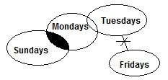

Slide 11
Statements:
Some Pencils are Pens
Only Pens are colours
Few Pencils are erasers
Conclusions:
1.Few colours may be pencils
2. Few erasers are pens
Only conclusion 2 follows
Neither conclusion 1 nor 2 follows
Only conclusion 1 follows
Both conclusion 1 and 2 follows
None of the above
Notes:
Ans : B

Slide 12


Slide 13
Statements:
Only few bats are balls
Few balls are stumps
No stump is pitch
Conclusions:
1.Some balls are not pitches
2. All bats are balls
Only conclusion 2 follows
Neither conclusion 1 nor 2 follows
Only conclusion 1 follows
Both conclusion 1 and 2 follows
None of the above
Notes:
Ans : c

Slide 14
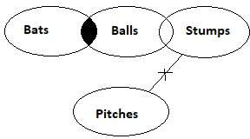

Slide 15
Statements:
All Rum is Whisky
No whisky is beer
Only beer is vodka
Conclusions:
1. No Rum is beer
2. Some vodka may be whisky
Only conclusion 2 follows
Neither conclusion 1 nor 2 follows
Only conclusion 1 follows
Both conclusion 1 and 2 follows
None of the above
Notes:
Ans : c

Slide 16
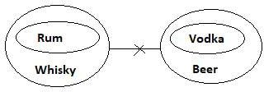

Slide 17
Statements:
All leaves are plants
No plant is seed
Conclusions:
1.All leaves may be seeds
2. Some petals are plants
Only conclusion 2 follows
Neither conclusion 1 nor 2 follows
Only conclusion 1 follows
Both conclusion 1 and 2 follows
None of the above
Notes:
Ans : a

Slide 18
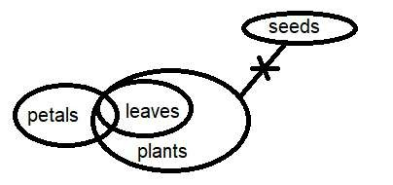

Slide 19
Statements:
All bowls are glasses
Each bowl is cup
No box is bowl
Conclusions:
1.All bowls are glasses
2. Some cups are boxes
Only conclusion 2 follows
Neither conclusion 1 nor 2 follows
Only conclusion 1 follows
Both conclusion 1 and 2 follows
None of the above
Notes:
Ans : c

Slide 20
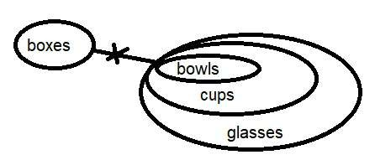

Slide 21
Statements:
No mobiles are laptops.
Only few laptops are computers.
Few computers are keyboards.
All keyboards are phones.
Conclusions:
Some laptops are not keyboards.
Each computers may be mobiles
Mostly phones are computers
Both conclusion I and conclusion II follow.
Only conclusion III follows
Neither conclusion I nor conclusion II follows
Only conclusion II follows
None of the above
Notes:
Ans : b

Slide 22
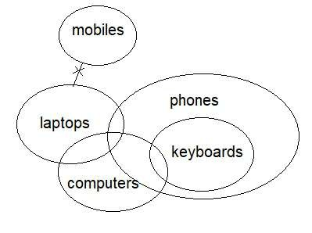

Slide 23
Thank You

